Slide 1
BUS MANAGEMENT SYSTEM

Slide 2
SOFTWARE REQUIREMENT SYSTEM (SRS)

Slide 3
The Main aim of Bus Management project is to ease the process of ticket booking and keeping records of buses and the drivers or the conductors.
We aim to demonstrate the use of create, read, update and delete MySQL
operations through this project.
This project starts by adding stations then adding details of employee either a driver or a conductor. Once,
registration is done user can add bus details with the route.
Now, the user can use the ticket counter to book tickets for the passengers.

Slide 4
Specifically, objectives of this project will consist of:
i) Providing a web-based bus ticket reservation function where a customer can buy bus
ticket through the online system without a need to queue up at the counter to purchase a
bus ticket.
ii) Enabling customers to check the availability and types of buses online. Customer can
check the time departure for every bus through the system.
iii) Easing bus ticket payment by obtaining a bank pin after payments is made to our
designated banks.
iv) Ability of customers to cancel their reservation.
vi) There will be a panic button in the app which will trigger our alarm system, for case of
emergency.
vii) Admin user privileges in updating and canceling payment, route and vehicle records.
viii) A driver or a conductor can be added by a user with admin privileges. On the other
hand, a user with roles such as Driver or conductor will login with their user-names and
password to find about their current journey.

Slide 5
ENTITY RELATIONSHIP DIAGRAM

Slide 6
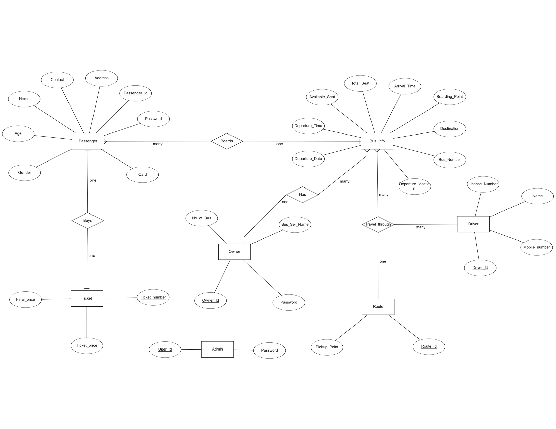

Slide 7
DATA FLOW DIAGRAM

Slide 8
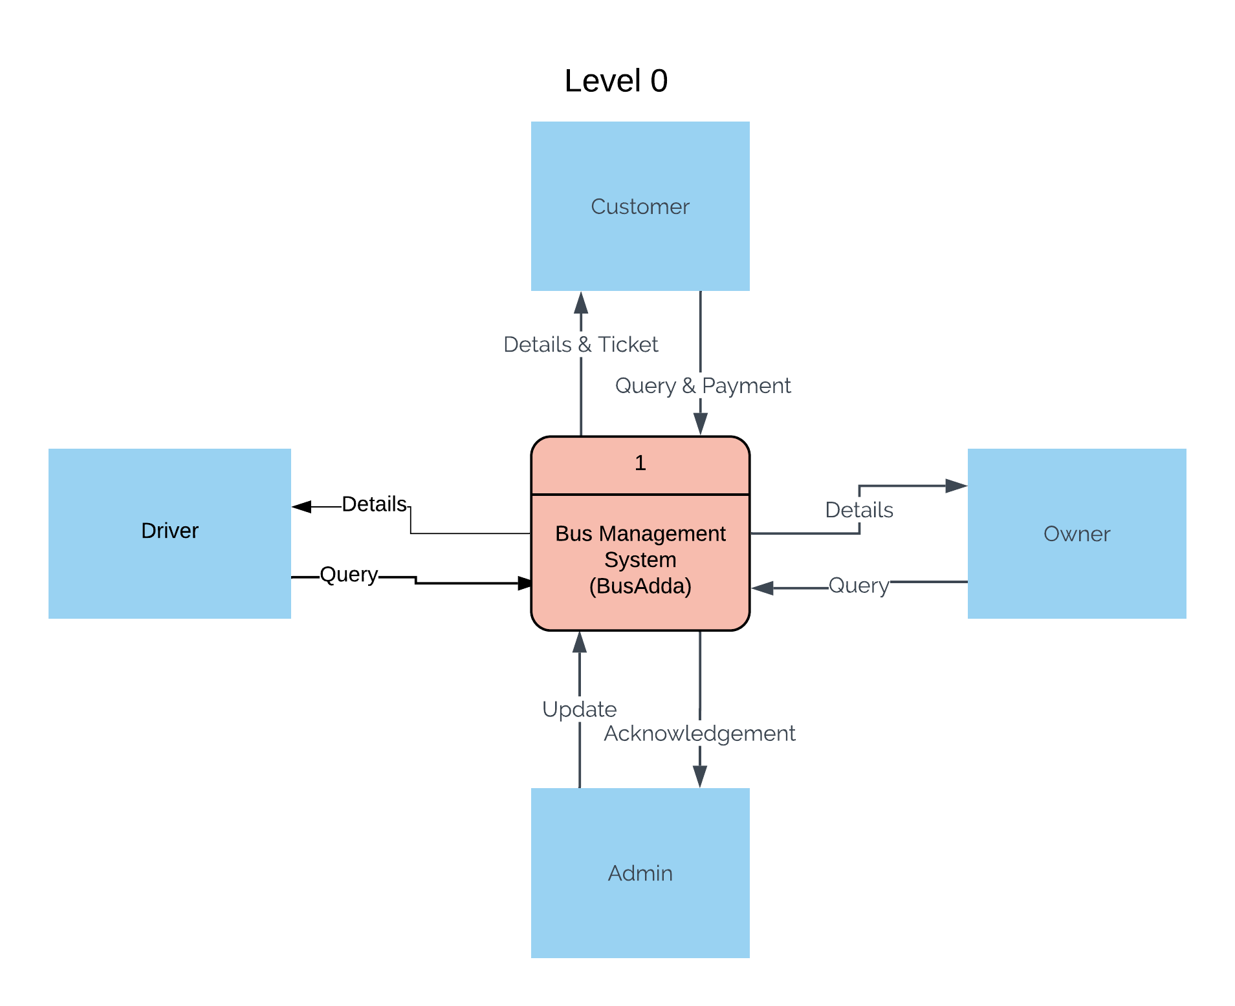
LEVEL 0

Slide 9
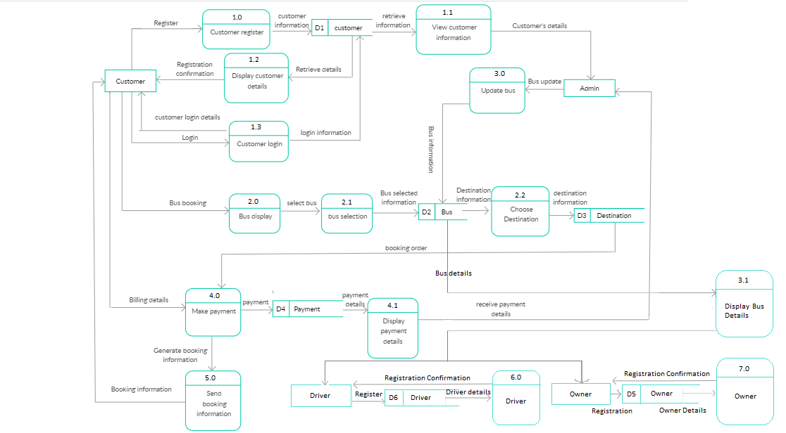
LEVEL 1

Slide 10
USE CASE DIAGRAM

Slide 11
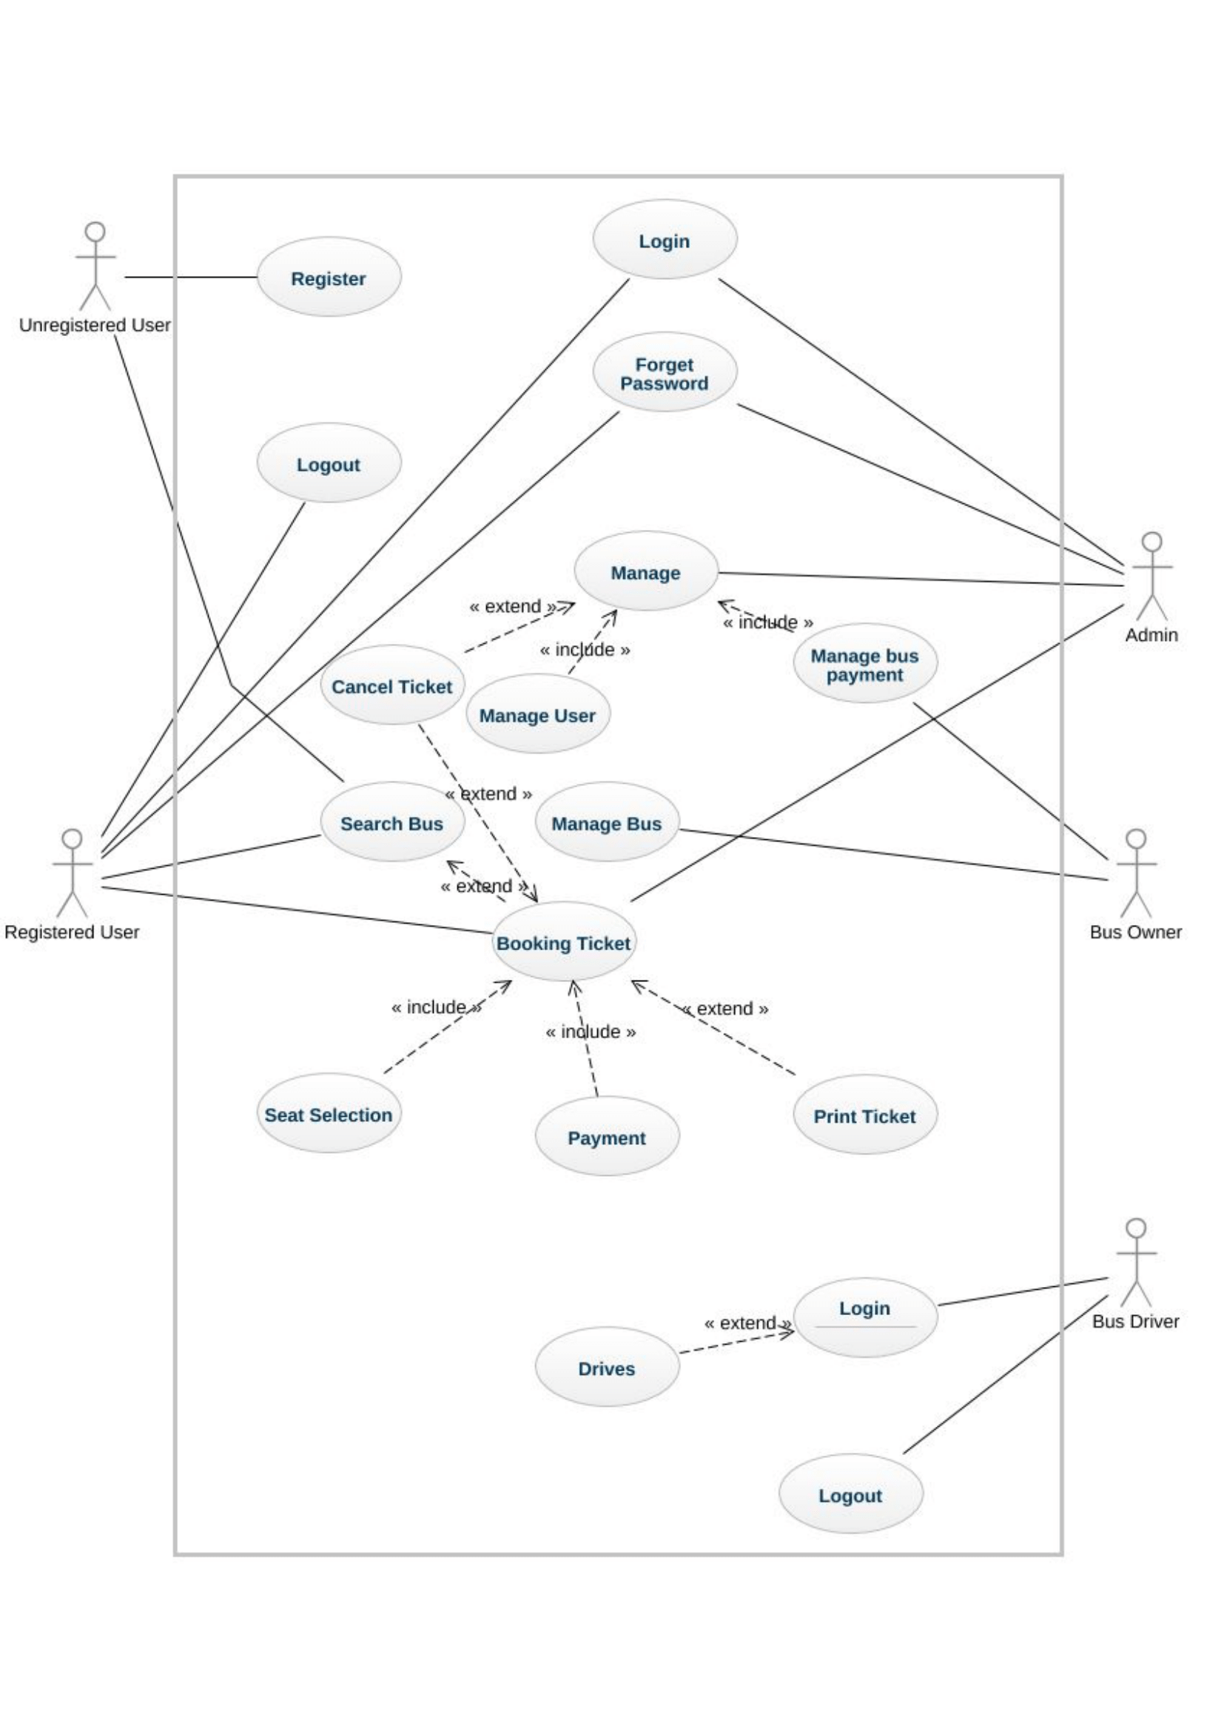

Slide 12
SEQUENCE DIAGRAMS

Slide 13
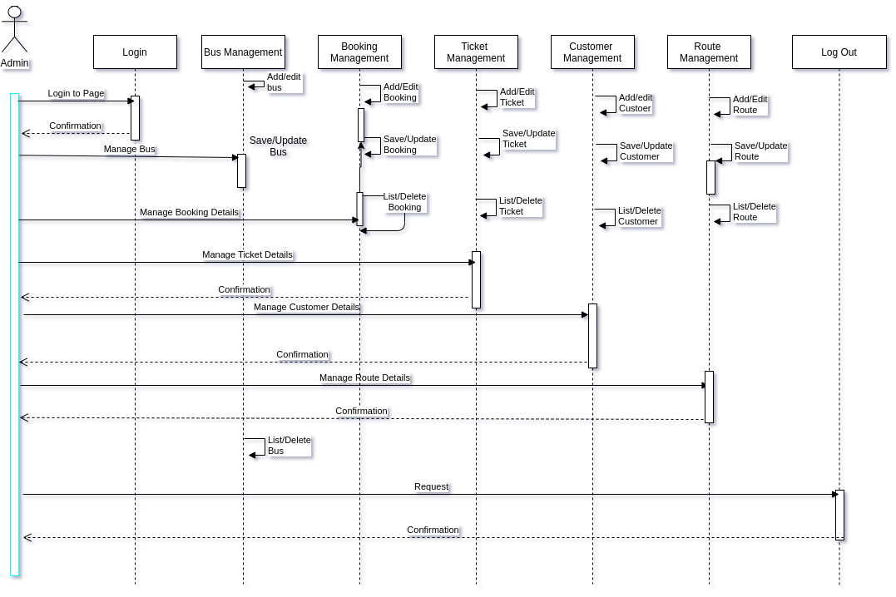
ADMIN

Slide 14
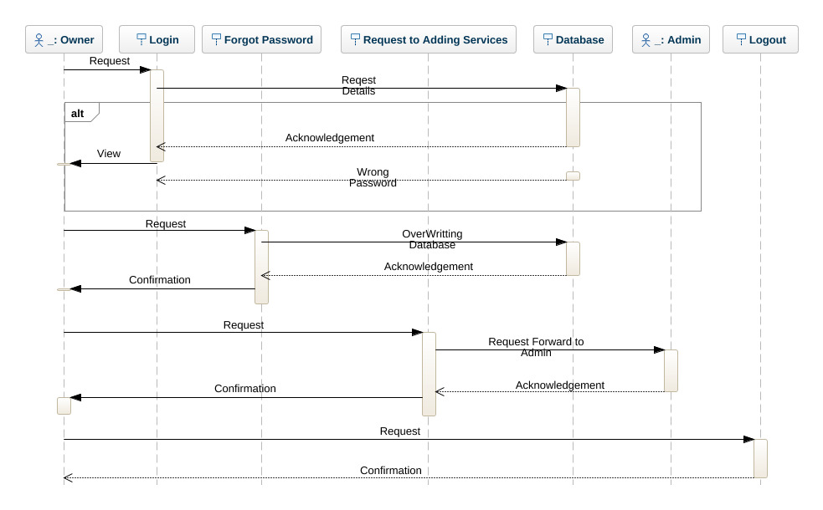
OWNER

Slide 15
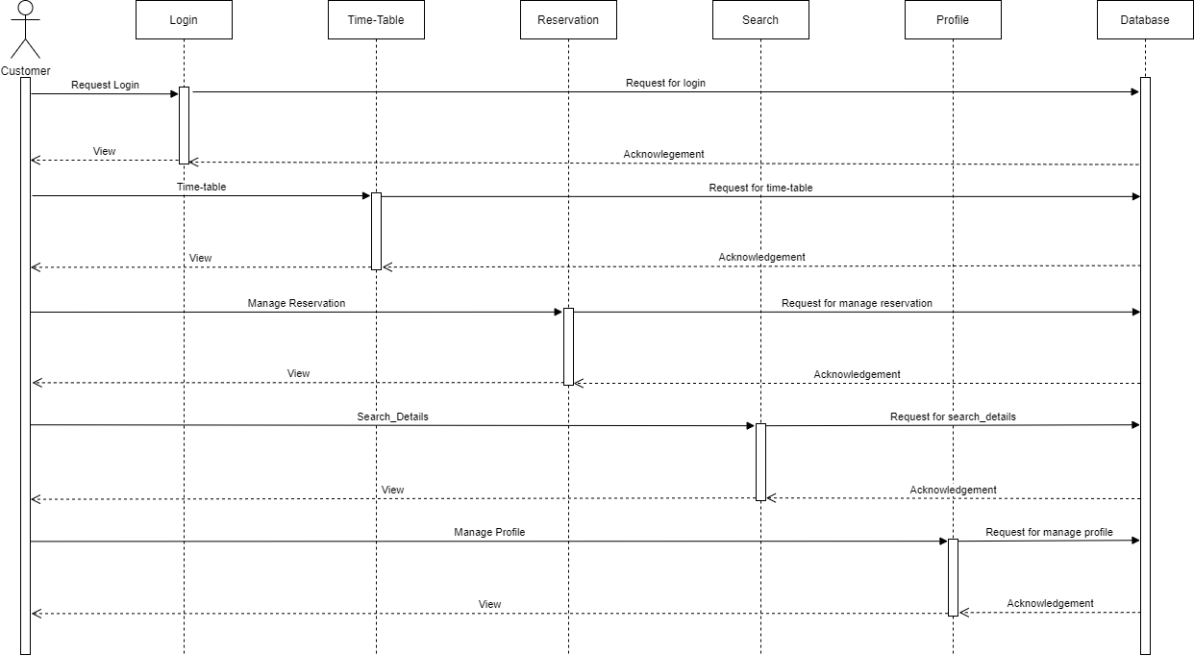
CUSTOMER

Slide 16
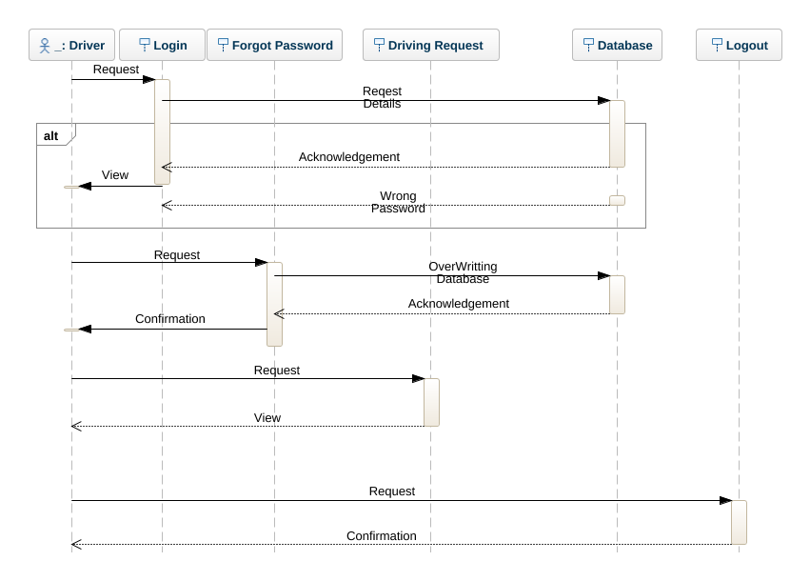
DRIVER

